Slide 1

Azure Event Grid
Event-based computing in Azure

Slide 2


Slide 4













Eventing in the cloud
Events
Event Handlers
Blob Storage
Serverless Code
Resource Groups
Functions
Azure Subscriptions
Event Grid
Serverless Workflow and Integration
Event Hubs
CloudEvents Format
Logic Apps
Azure Media Service
Buffering and
Competing Consumers
IoT Hub
Service Bus
Event Hubs
Storage
Queues
Custom Events (anything)
Other Services and Applications
CloudEvents Sources
Hybrid Connections
(WebSockets)
WebHooks (anything)
Azure Automation
Notes:
The Azure Serverless platform can now handle CloudEvents as well as emit all Azure platform events in CloudEvents format, natively. We also now support BYO JSON formats with input bindings in addition to continued support for the native Azure format. In facet any permutation of the three is supported, so you can ingest your proprietary event format into Event Grid and react to it with an Azure function, or just as easily fire a Blog Storage event off to nearly every major functions platform available today – and because we convert it on the wire to CloudEvents format, you have a native, uniform experience wherever you are.

Slide 5
Azure Event Grid
Fully-managed event routing
Near real-time event delivery at scale
Broad coverage within Azure and beyond
Backbone of event-driven computing

Slide 6
Benefits
Focus on innovation and pay per event
Ensure reliability and performance for your apps
Unlock new scenarios for your apps
Manage all events in one place

Slide 7
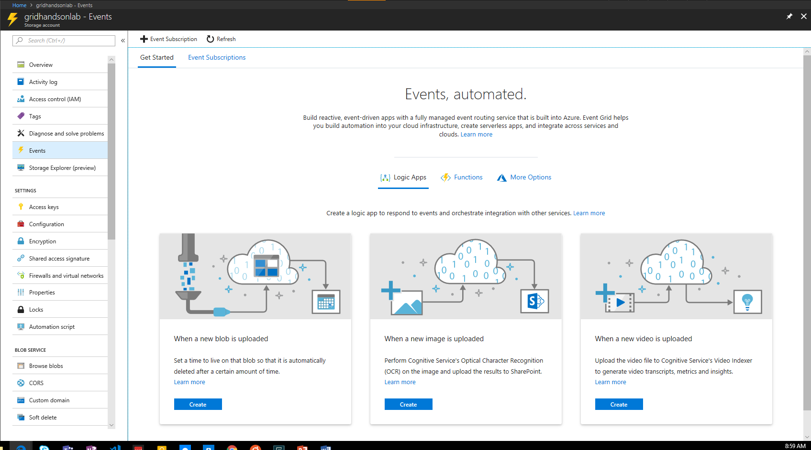
Manage all events in one place

Slide 8




Build applications efficiently
Management SDKs
Publish SDKs
Event Schema Store
Consumption SDKs
.Net Python Java Node.js Ruby Go

Slide 9
Ensure reliability and performance in your apps
SLA backed 99.99% availability
10,000,000 events per second per region
24-hour retry with exponential back off for events not delivered
High availability
Massive scale-out
High reliability

Slide 10
Benefit from broad coverage
Publishers
Subscribers
Coming Soon
Immediately available
Immediately available
Publishers
Azure Active Directory, API Management, Service Bus, Azure Data Lake Store, Cosmos DB, Azure Container Registry, Azure Security Center, Azure Media Services, KeyVault, Azure Container Instances, Azure Batch, Analytics
Blob Storage
Azure Functions
Resource Groups
Logic Apps
Azure Subscriptions
Azure Automation
Event Hubs
WebHooks
Subscribers
Service Bus, Azure Data Factory, Storage Queues, Azure Container Instances
Custom Events
Event Hubs
IoT Hub
General Purpose Storage v2
Service Bus

Slide 11
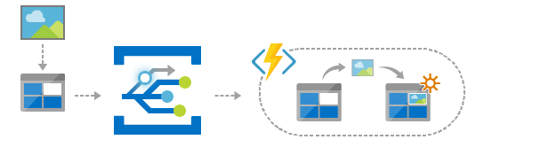
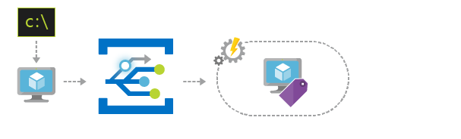
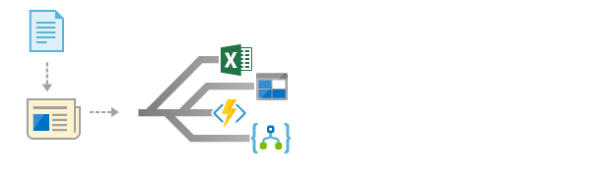
Scenarios
Serverless apps
Ops automation
Application integration
Instantly trigger a serverless function to run analysis when a new file is added to a blob storage container.
Speed up automation and simplify policy enforcement by notifying Azure Automation when underlying infrastructure is provisioned
Connects your app with other services. Create an application topic to route your app’s event data to any desired destination

Slide 12
Sample Event
[{
"topic": "/subscriptions/{subscription-id}/resourceGroups/Storage/providers/Microsoft.Storage/storageAccounts/xstoretestaccount“,
"subject": "/blobServices/default/containers/testcontainer/blobs/testfile.txt",
"eventType": "Microsoft.Storage.BlobCreated",
"eventTime": "2017-06-26T18:41:00.9584103Z",
"id": "831e1650-001e-001b-66ab-eeb76e069631",
"data": {
"api": "PutBlockList",
"clientRequestId": "6d79dbfb-0e37-4fc4-981f-442c9ca65760",
"requestId": "831e1650-001e-001b-66ab-eeb76e000000",
"eTag": "0x8D4BCC2E4835CD0",
"contentType": "text/plain",
"contentLength": 524288,
"blobType": "BlockBlob",
"url": "https://example.blob.core.windows.net/testcontainer/testfile.txt",
"sequencer": "00000000000004420000000000028963",
"storageDiagnostics": {
"batchId": "b68529f3-68cd-4744-baa4-3c0498ec19f0"
}
},
"dataVersion": "",
"metadataVersion": "1“
}]

Slide 13

Learn more at azure.com/EventGrid

